Slide 1
Ranking Templates for Linear Loops
Jan Leike, Matthias Heizmann. 2014 TACAS
韩济涛
2020.08.24

Slide 2
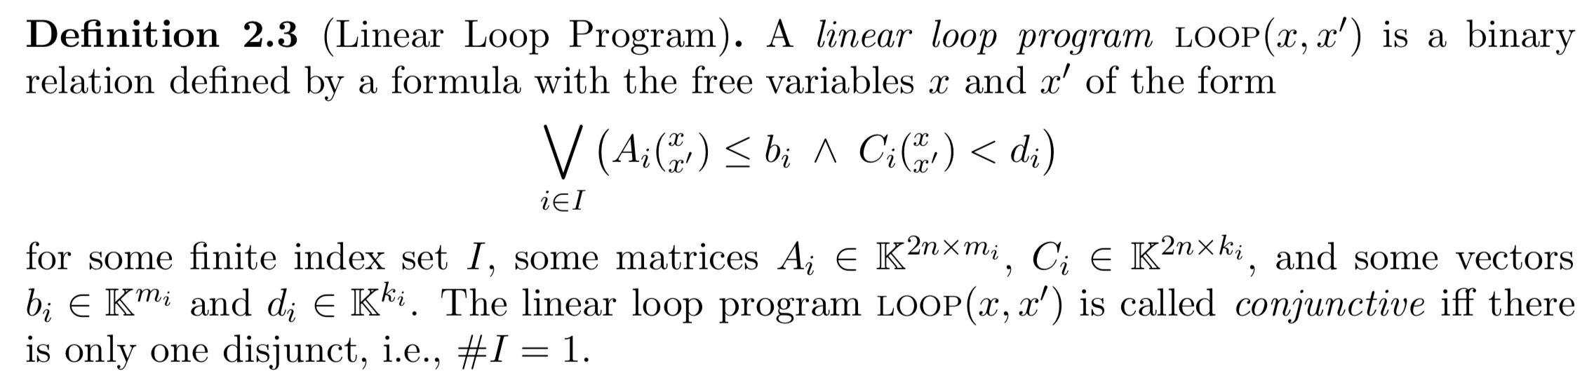
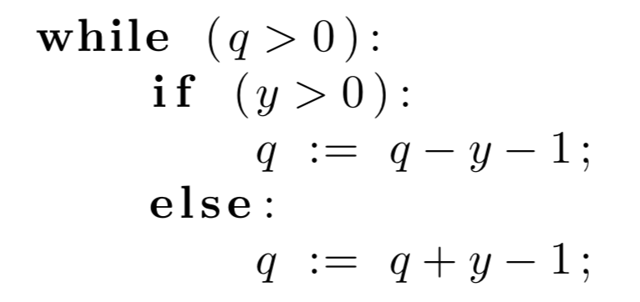
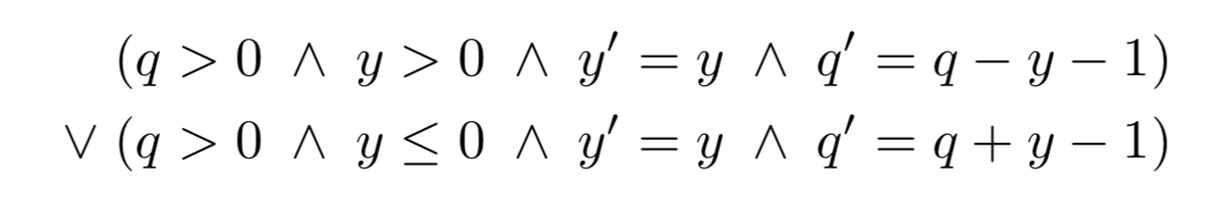
Linear Loop Programs

Slide 3
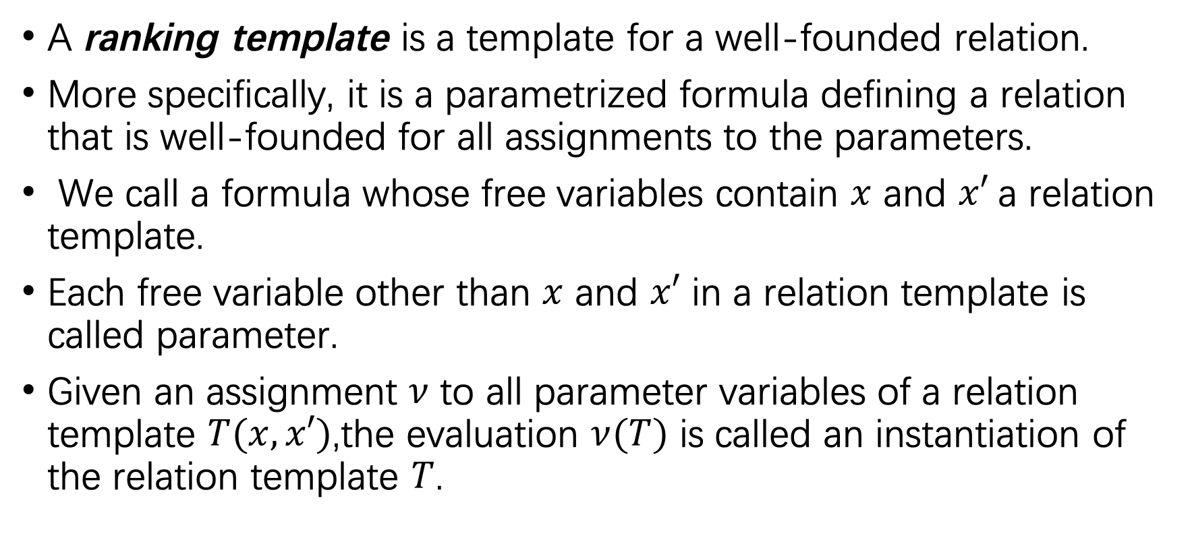
Ranking Templates
A ranking template is a template for a well-founded relation.
More specifically, it is a parametrized formula defining a relation that is well-founded for all assignments to the parameters.
We call a formula whose free variables contain $x$ and $x′$a relation template.
Each free variable other than $x$ and $x′$ in a relation template is called parameter.
Given an assignment $ν$ to all parameter variables of a relation template $T(x,x′)$,the evaluation $ν(T)$ is called an instantiation of the relation template $T$.

Slide 4
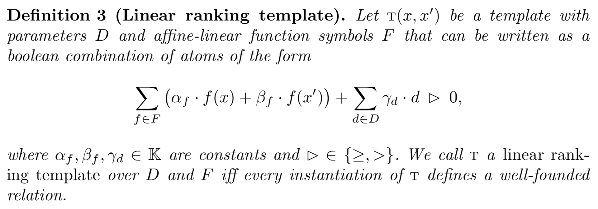
Ranking Templates

Slide 5
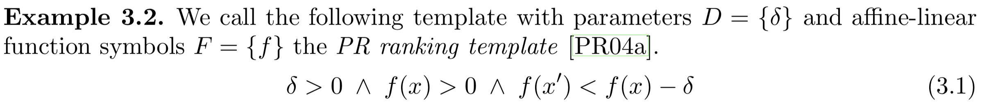
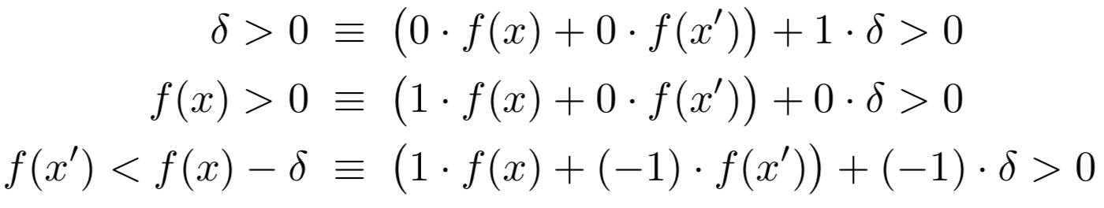
Ranking Templates

Slide 6
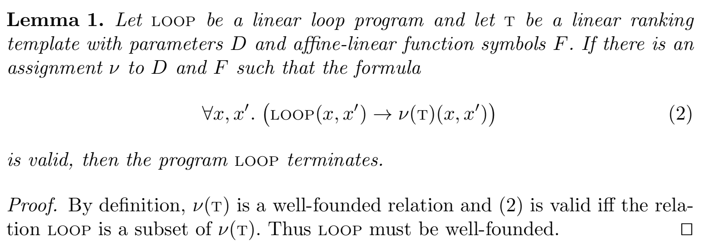
Ranking Templates

Slide 7
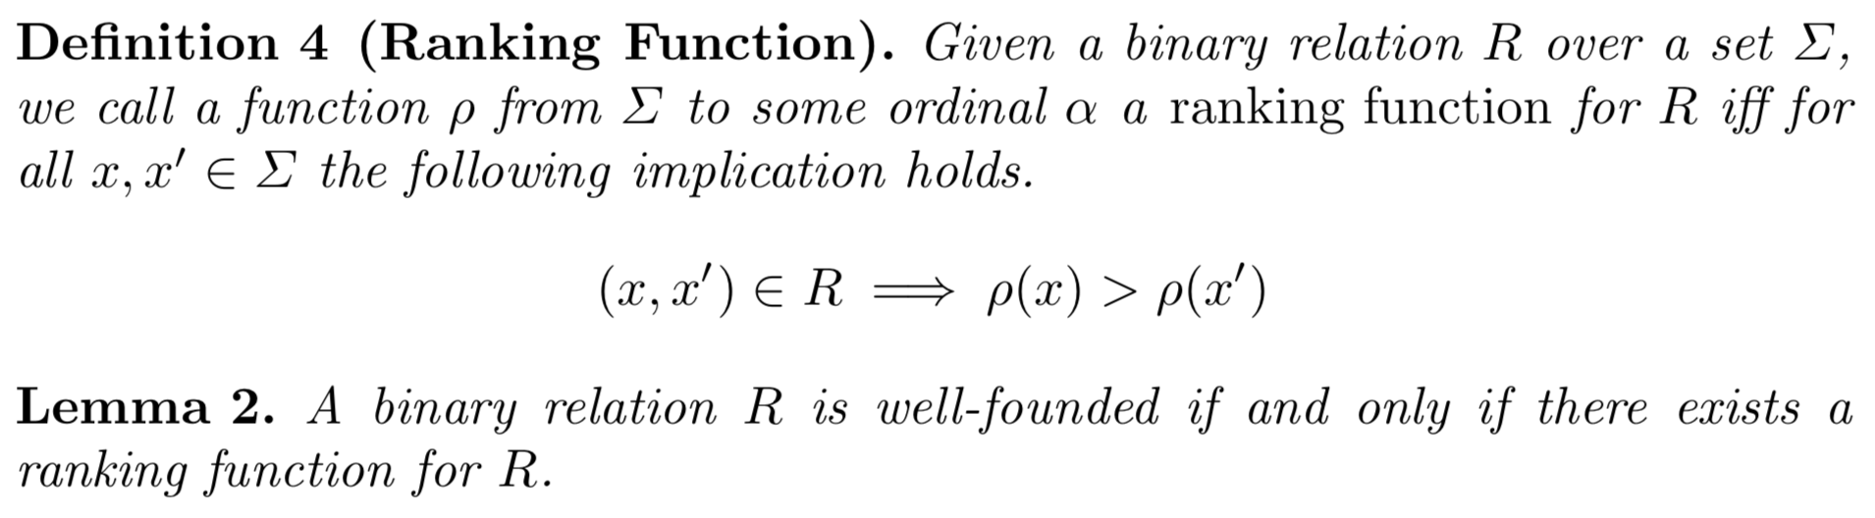
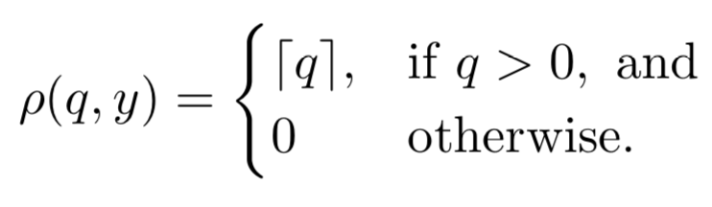
Ranking Templates

Slide 8
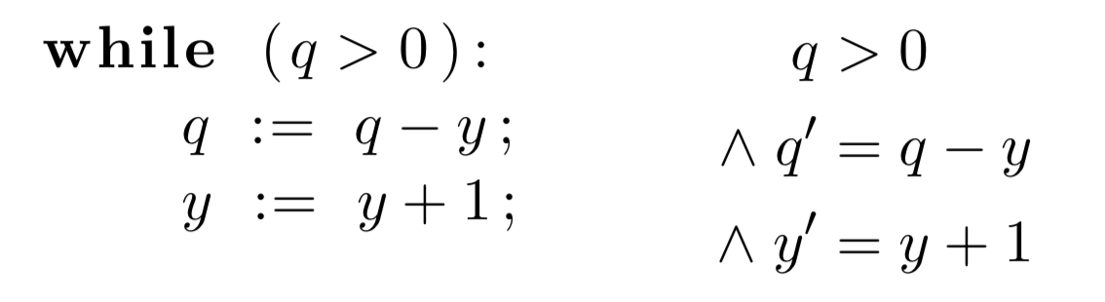
Multiphase Ranking Template
Target programs that go through a finite number of phases in their execution.
Each phase is ranked with an affine-linear function
Each phase is considered to be completed once the function becomes non-positive.
Every execution can be partitioned into two phases:
Phase 1: y increases until it is positive
Phase 2: q decreases until the loop condition q > 0 is violated.
Depending on the initial values of y and q, one or more phases might be skipped altogether.

Slide 9
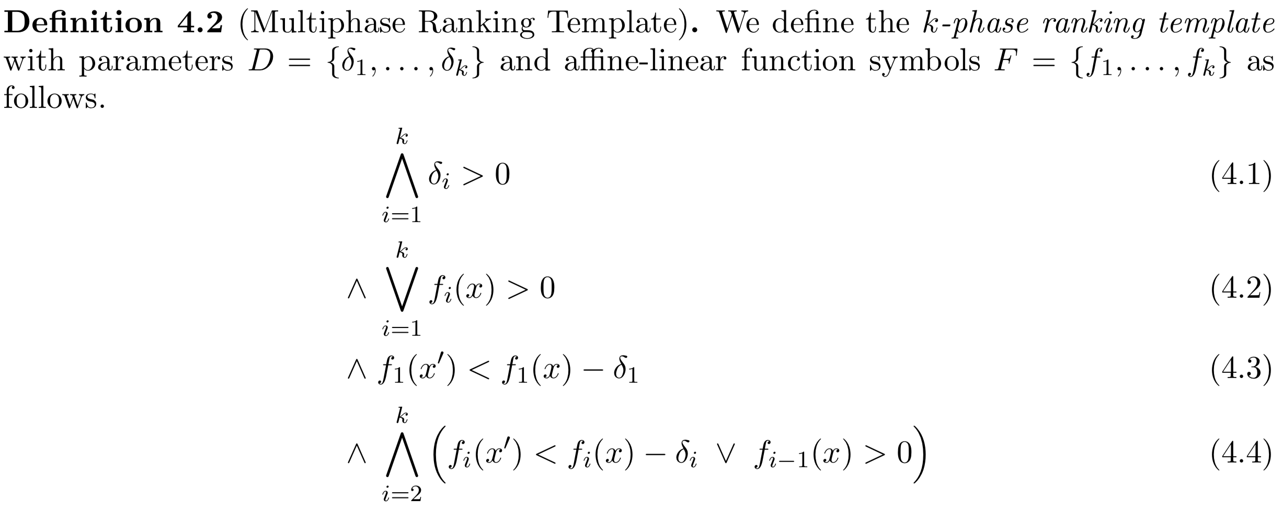
Multiphase Ranking Template
fi(x) > 0 and fj(x) ≤ 0 for all j < i.
Condition (4.2) states that there is always some i such that the multiphase ranking function is in phase i.
Conditions (4.3) and (4.4) state that if we are in a phase ≥ i, then fi has to be decreasing by at least δi > 0.

Slide 10
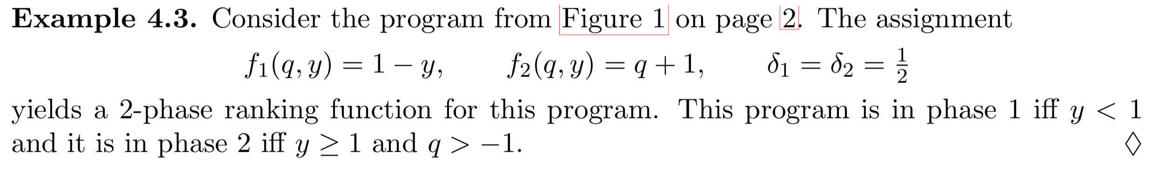
Multiphase Ranking Template

Slide 11
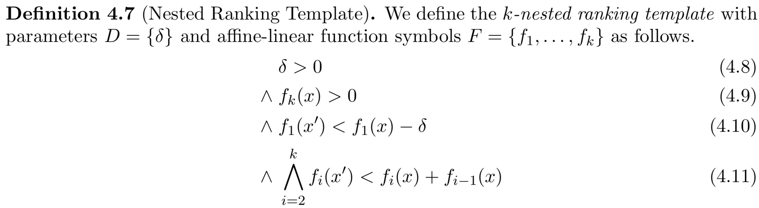
The Nested Ranking Template
Target programs that go through a finite number of phases in their execution.
Each phase is ranked with an affine-linear function ,
but this affine-linear function cannot increase by more than the value of the previous phase’s affine-linear function

Slide 12
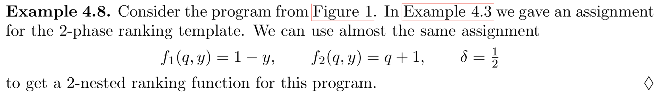
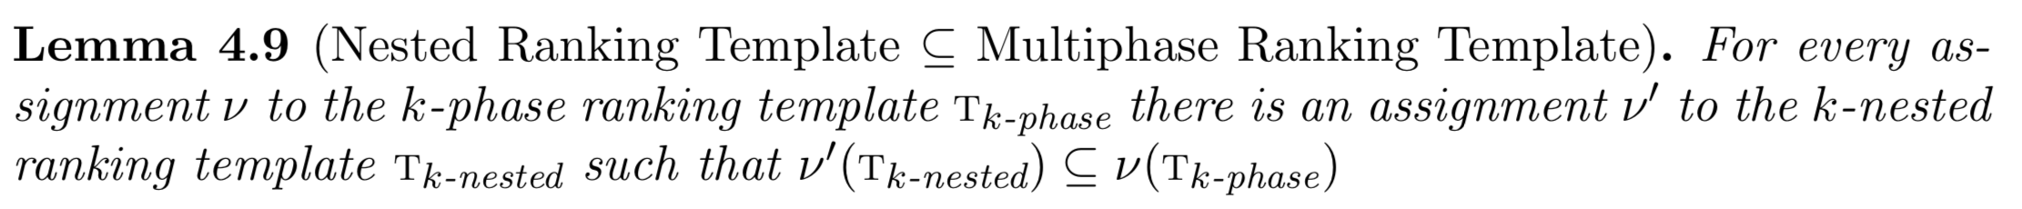
The Nested Ranking Template

Slide 13
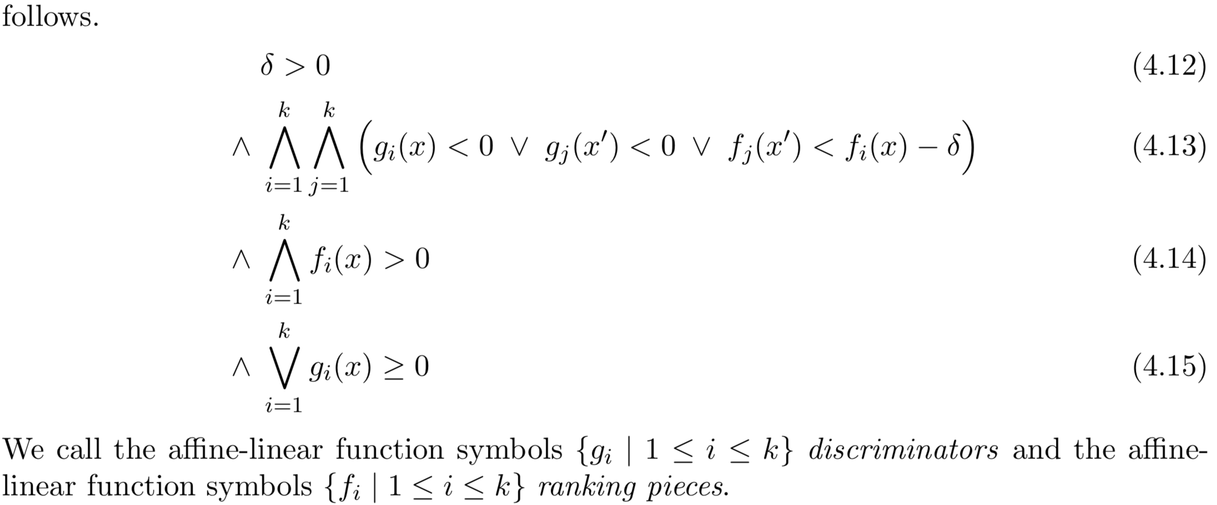
The Piecewise Ranking Template
Given the $k$ different pieces $f_{1}$, . . . , $f_{k}$ and a state $x$, we use $f_{i}$ as a ranking function only if $g_{i}(x)≥0$ holds.

Slide 14
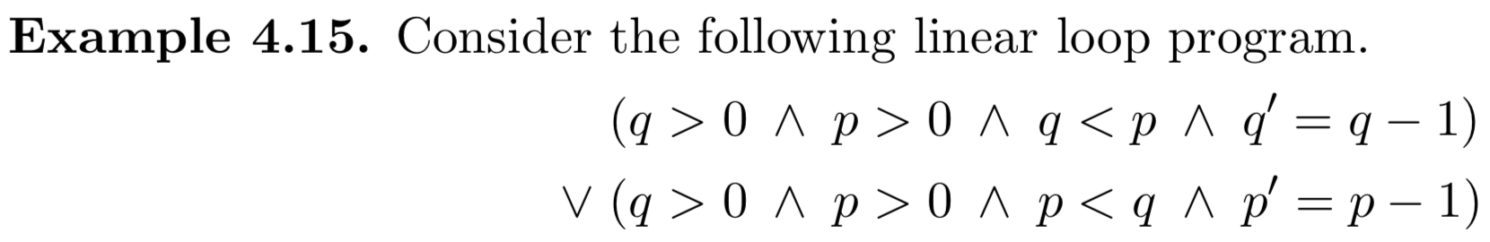
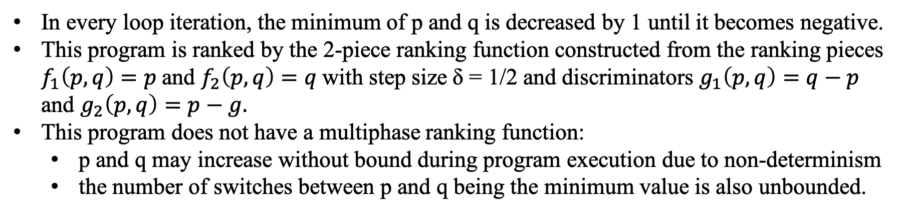
The Piecewise Ranking Template
In every loop iteration, the minimum of p and q is decreased by 1 until it becomes negative.
This program is ranked by the 2-piece ranking function constructed from the ranking pieces $f_{1}\left(p,q\right)=p$and $f_{2}\left(p,q\right)=q$with step size δ = 1/2 and discriminators $g_{1}\left(p,q\right)=q−p$ and $g_{2}\left(p,q\right)=p−g.$
This program does not have a multiphase ranking function:
p and q may increase without bound during program execution due to non-determinism
the number of switches between p and q being the minimum value is also unbounded.

Slide 15
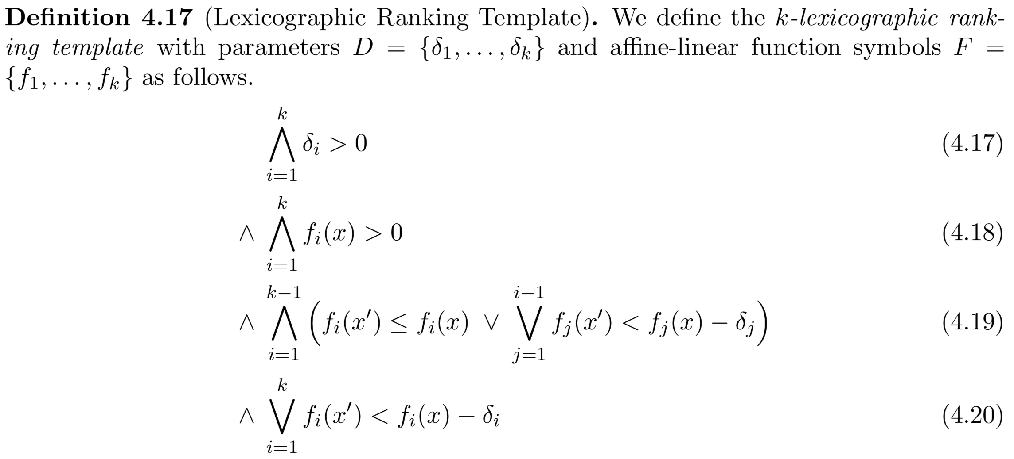
The Lexicographic Ranking Template
Lexicographic ranking functions consist of lexicographically ordered components of affine-linear functions.
A state is mapped to a tuple of values.
The loop transition leads to a decrease with respect to the lexicographic ordering for the tuple.
At every step, there must be at least one function that decreases.

Slide 16
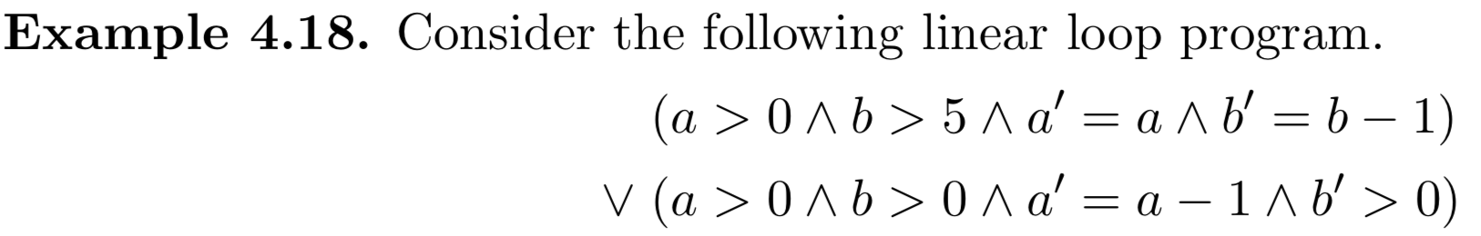
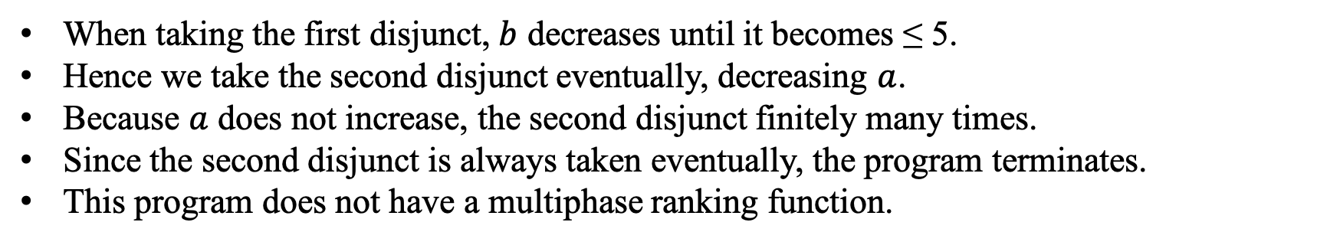
The Lexicographic Ranking Template
When taking the first disjunct, $b$ decreases until it becomes ≤ 5.
Hence we take the second disjunct eventually, decreasing $a$.
Because $a$ does not increase, the second disjunct finitely many times.
Since the second disjunct is always taken eventually, the program terminates.
This program does not have a multiphase ranking function.
a=4, b=6: f=(a,b), (4, 6), (4,5), (3,1), (2,7), (2,6), (2,5), (1,3), (0,9)

Slide 17
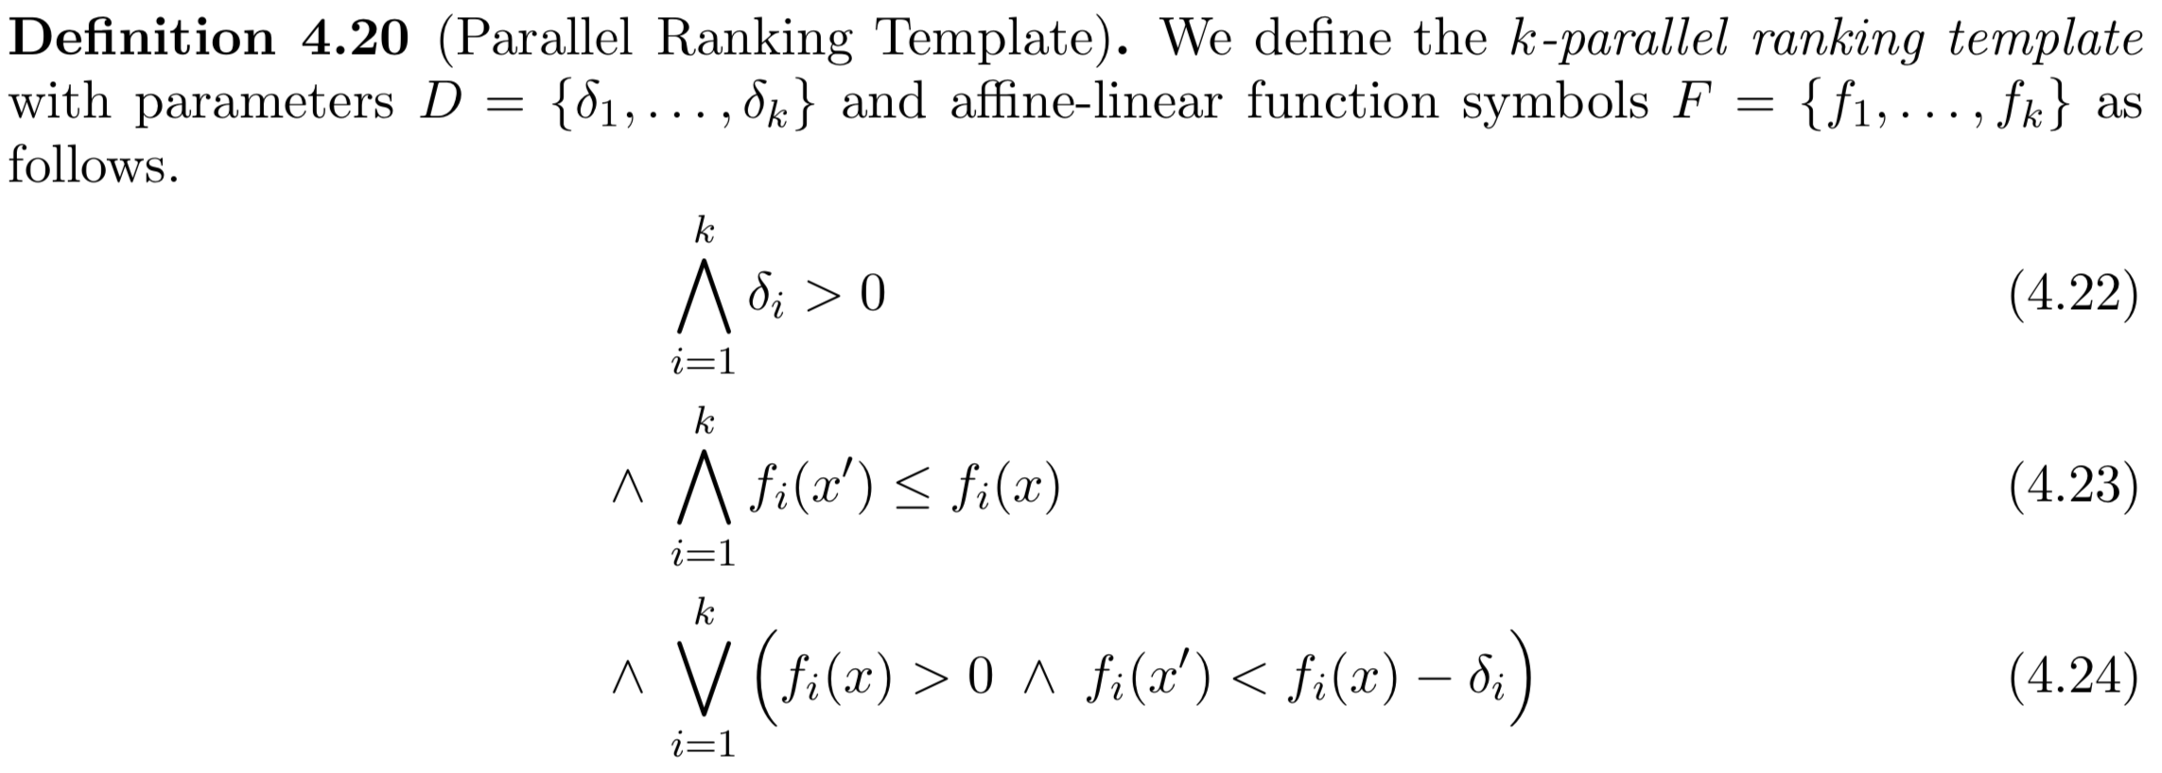
The Parallel Ranking Template
Targets programs that do multiple tasks in parallel where progress on each task can be nondeterministic.
These tasks have no predetermined order of execution.
We assume that each task can be ranked by an affine-linear ranking function.

Slide 18
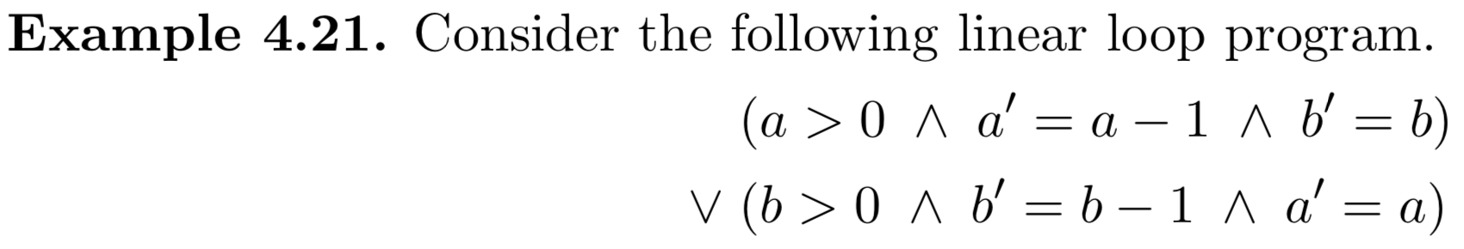
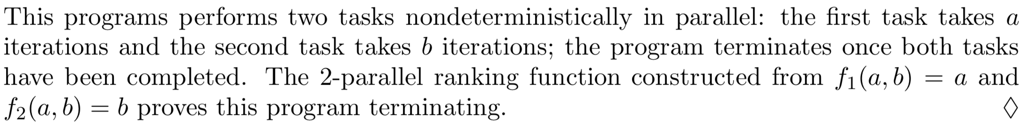
The Parallel Ranking Template

Slide 19
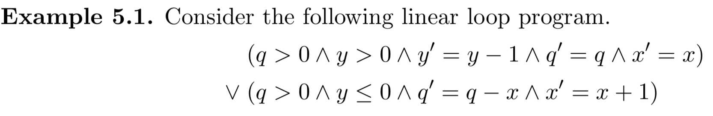
Composition of Templates
Now, we consider a program that is terminating, but whose termination cannot be proven using one of the ranking templates presented so far.
When executing the first disjunct, y decreases until it becomes negative.
Then we execute the second disjunct: we increment x, set y to some arbitrary value, and decrement q if x is positive.
If y was reset to some positive value, the first disjunct is executed again, but the values of q and x do not change until the second disjunct is executed.
Eventually, x is positive and from then on q is decremented until it is nonpositive; thus the program terminates.

Slide 20
Composition of Templates
The program’s behavior resembles a lexicographic ranking function with q as the first component and y as the second.
f(q=4,y=2,x=1)=(q,y), (4, 2), (4,1), (4,0), (3,-2), (1,2), (1,1), (1,0), (-2,7)
f(q=4,y=2,x=-2)=(q,y), (4, 2), (4,1), (4,0), (6,-2), (5,-2)…
q is decremented only after x becomes positive: the first component needs 2 phases.
We want a ranking template for a lexicographic ranking function that has multiphase ranking functions instead of affine-linear functions in every component.
How can we construct a linear ranking template for such a ranking function?

Slide 21
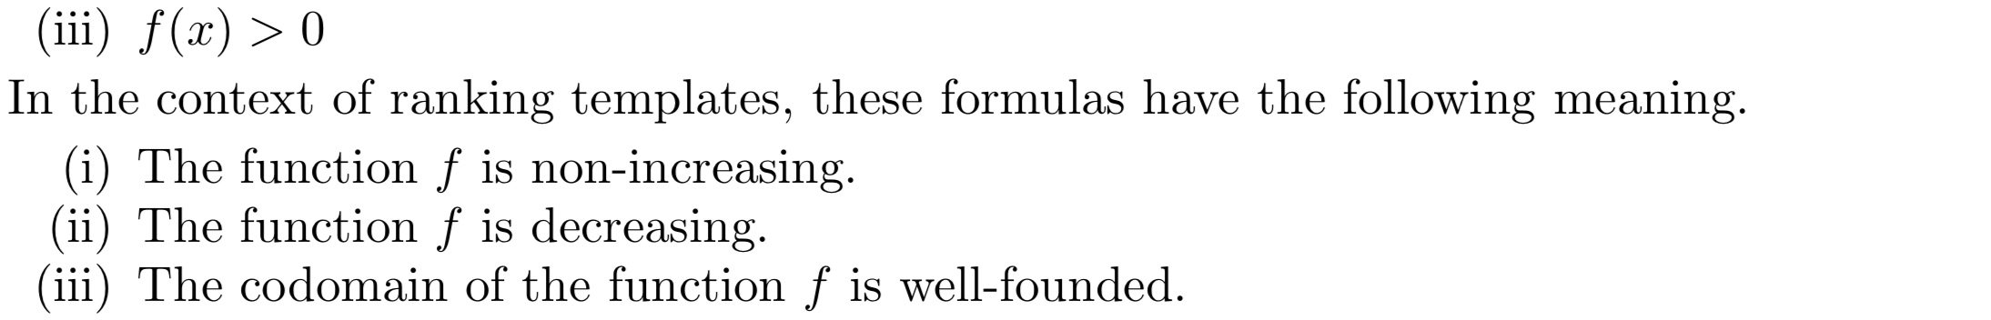
Composition of Templates
Here f is always an affine-linear function.
The idea of template composition is to replace the subformulas (i–iii) with subformulas of the same meaning for more powerful functions.
We next define triples of formulas that are suitable substituents for (i–iii), called composed template recipes.
Afterwards, we will use composed template recipes to build new linear ranking templates.

Slide 22
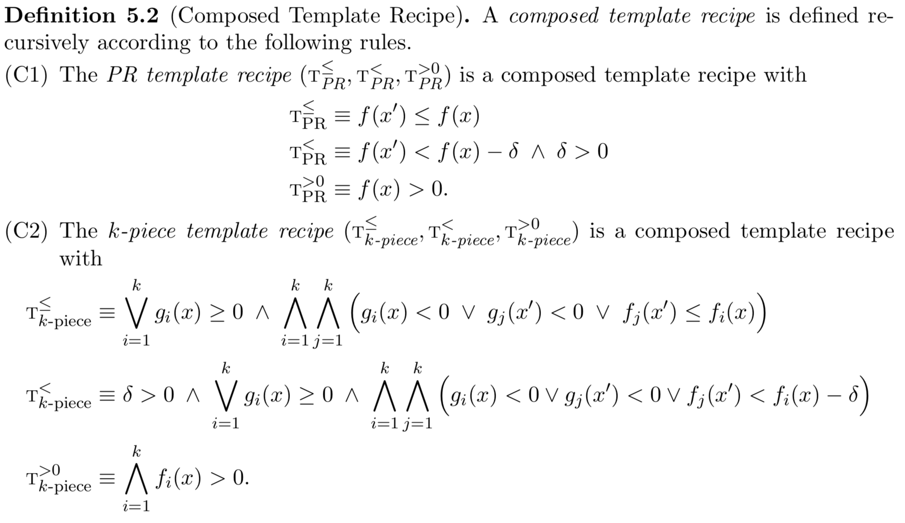
Composition of Templates

Slide 23
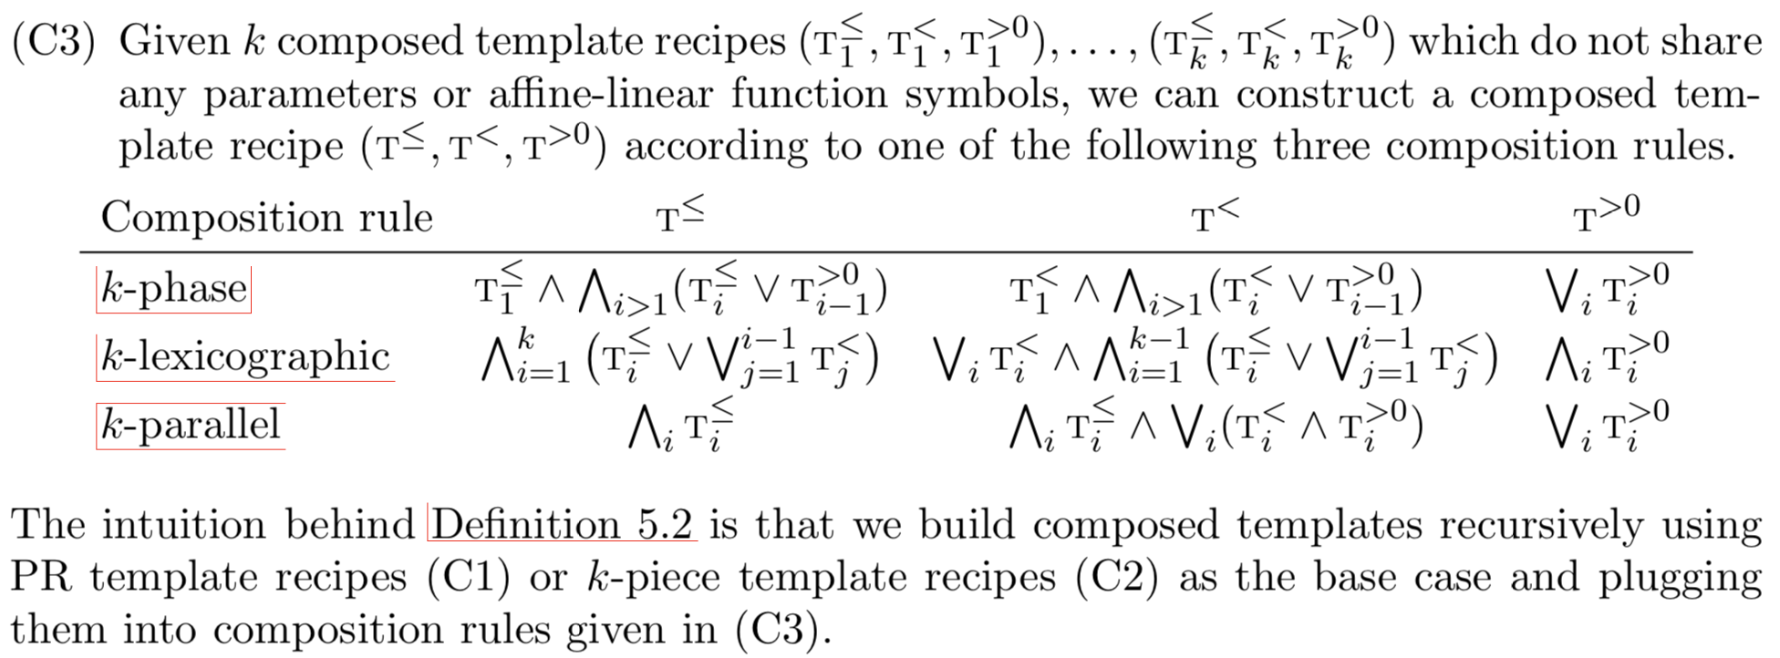
Composition of Templates

Slide 24
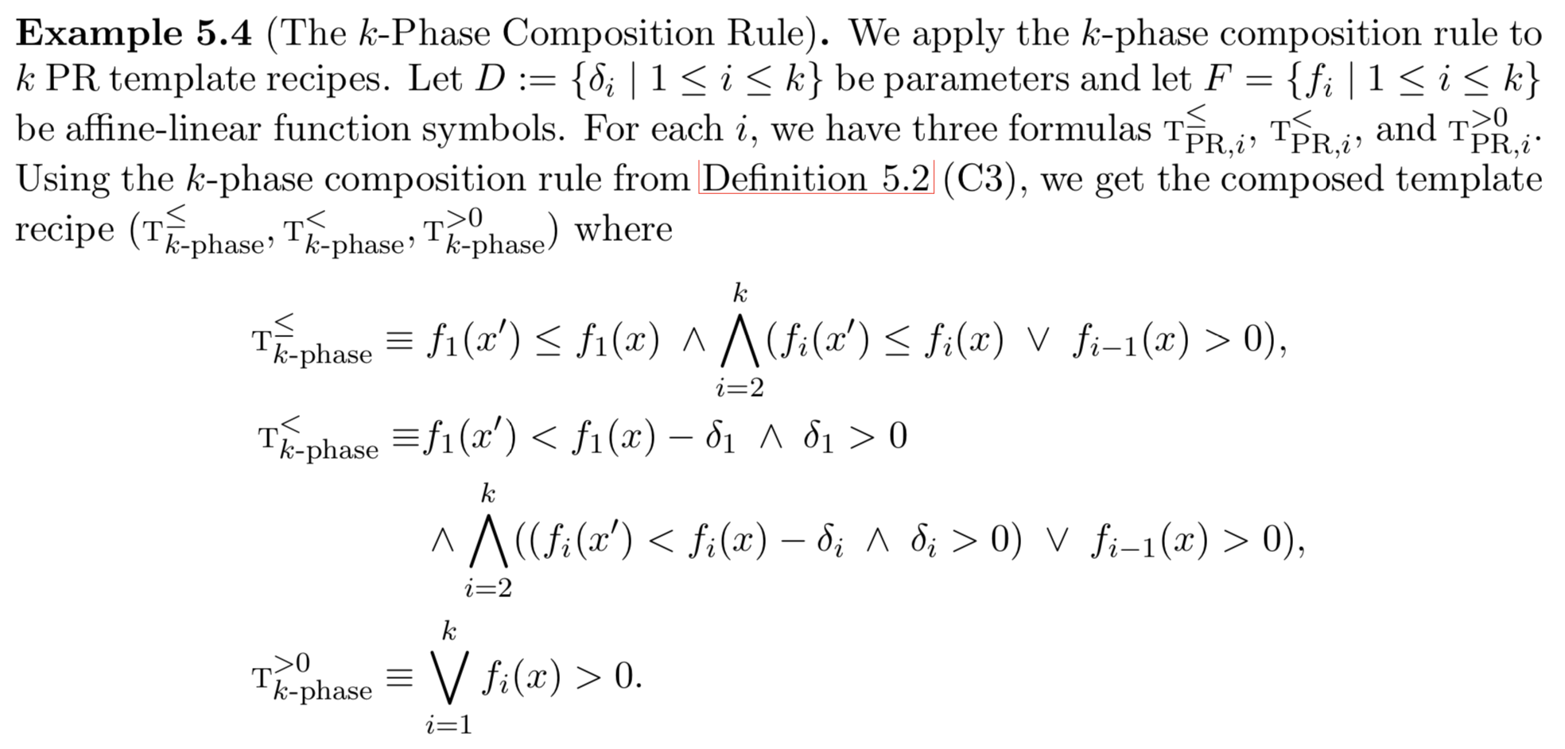
Composition of Templates

Slide 25
Composition of Templates

Slide 26
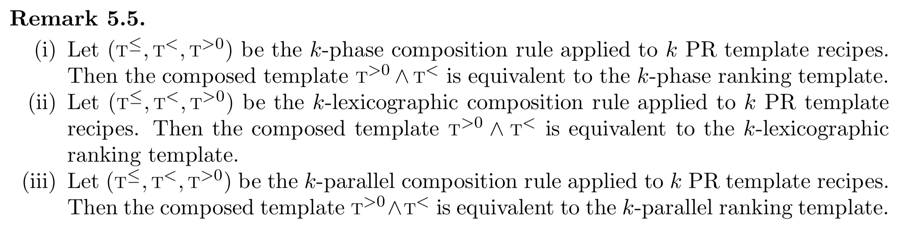
Composition of Templates

Slide 27
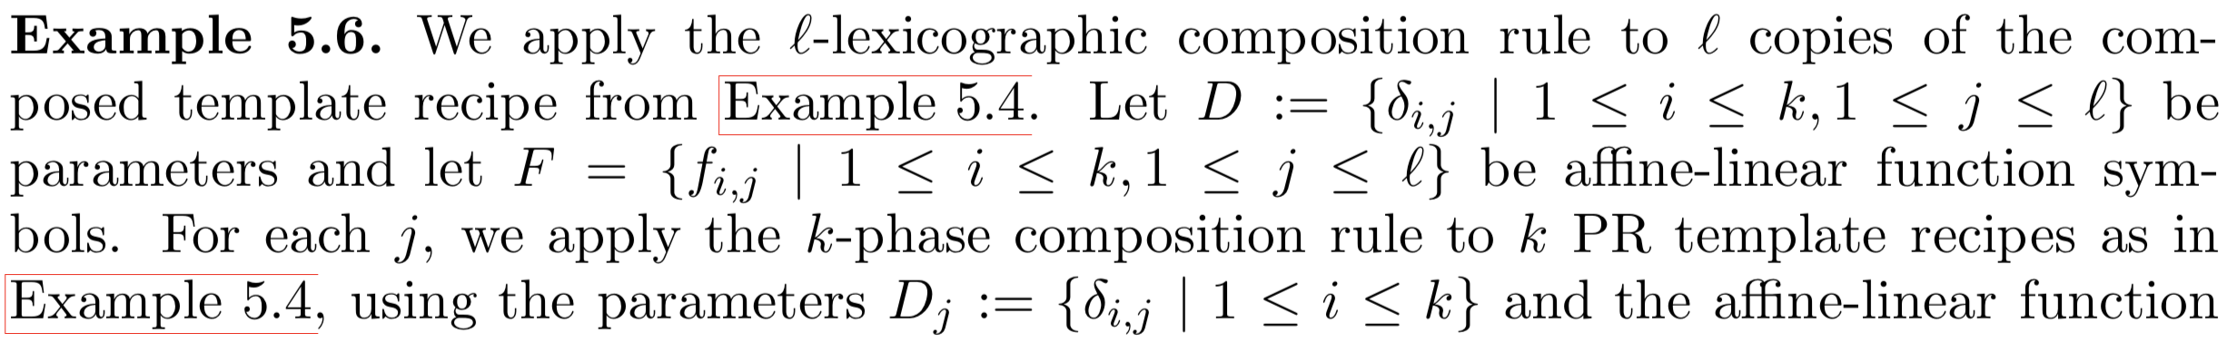
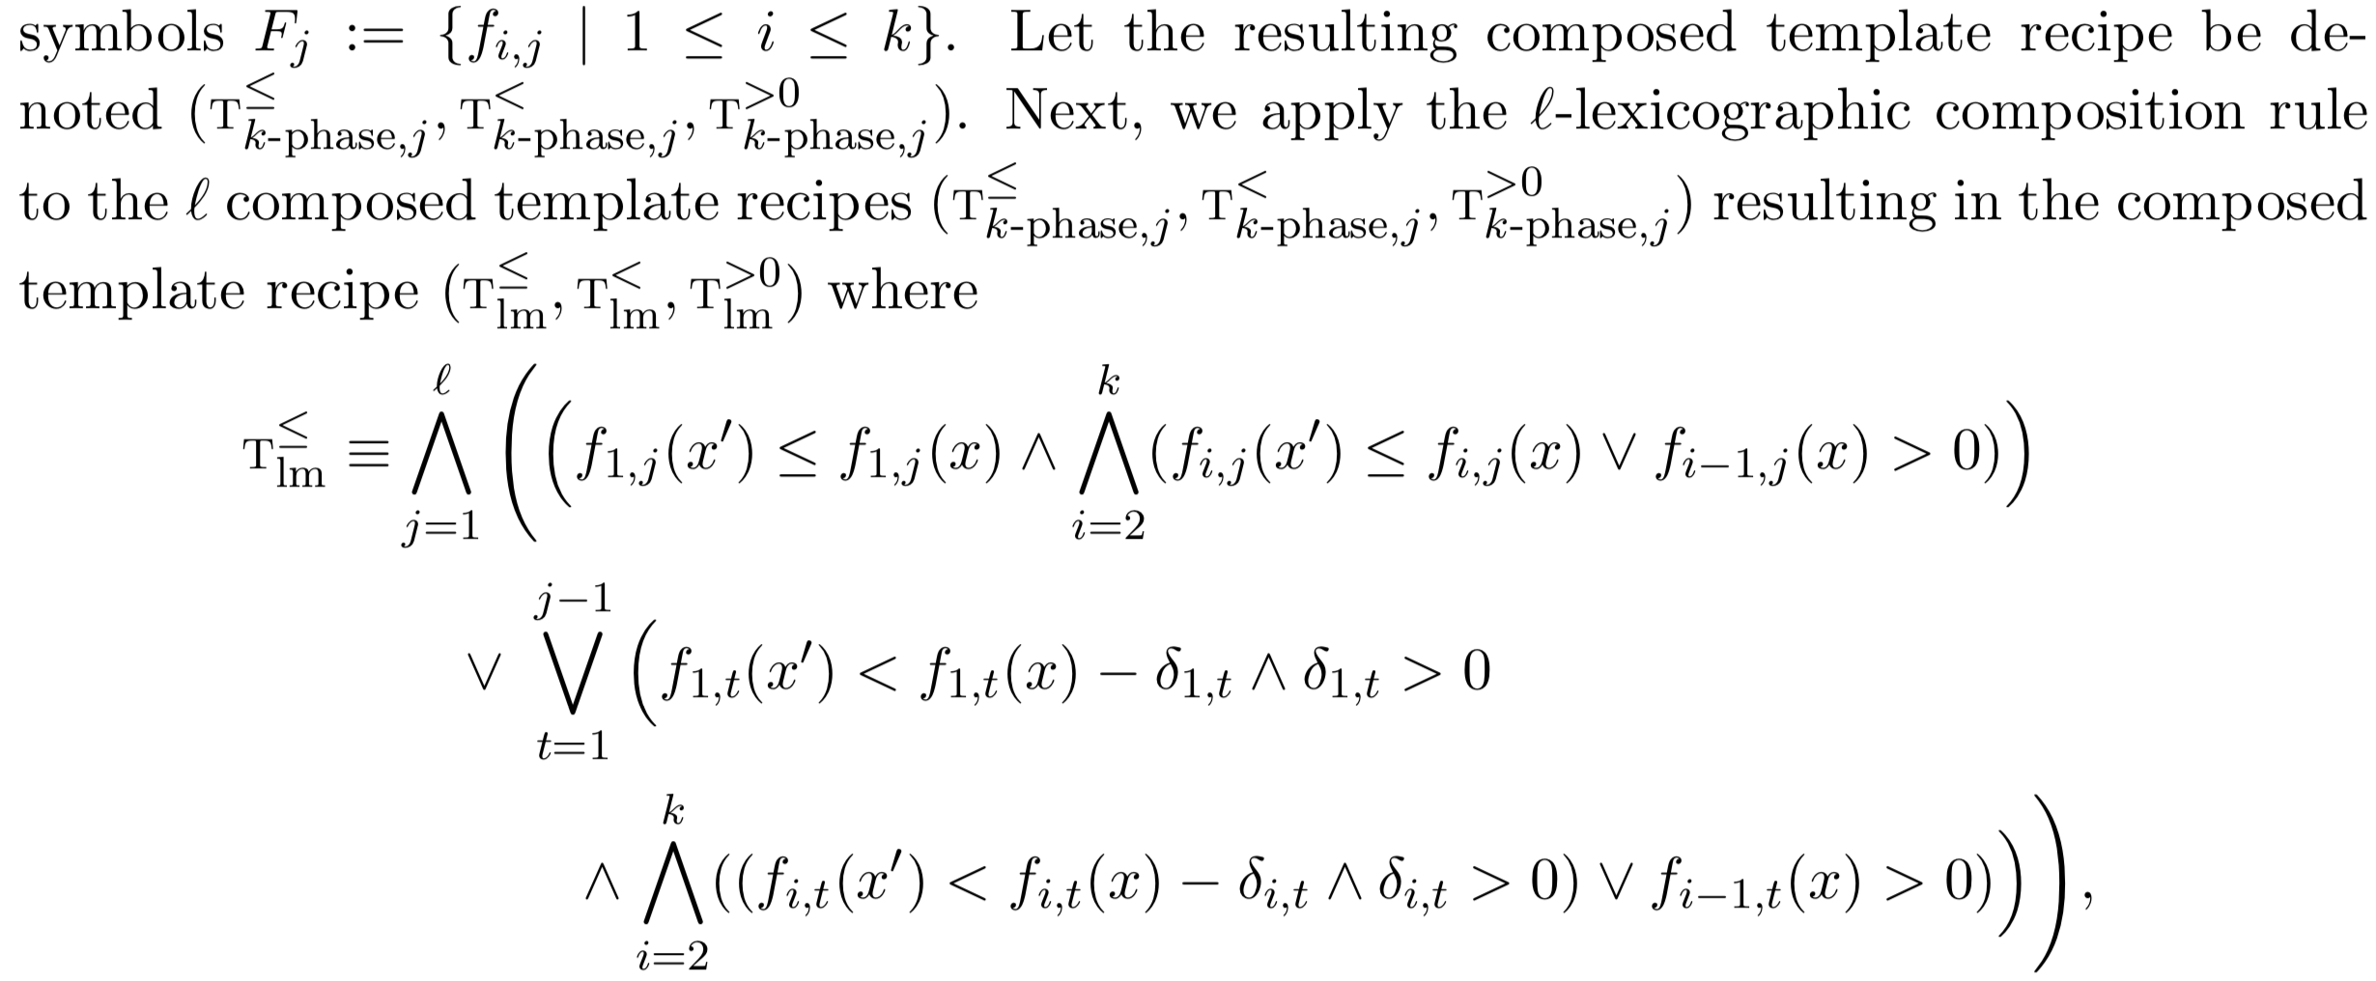
Composition of Templates

Slide 28
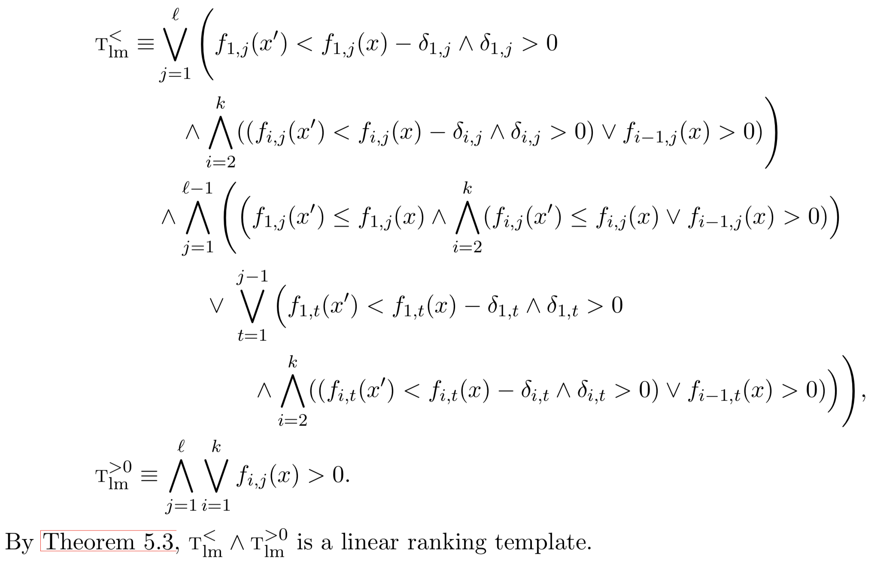
Composition of Templates

Slide 29
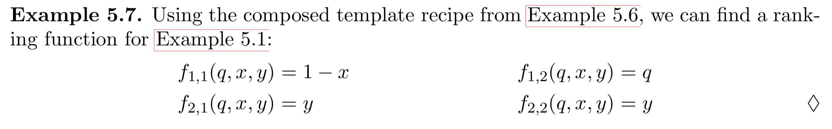
Composition of Templates
x=-1, q=2, y=2 (2,2,2,2), (2,2,1,1), (2,2,0,0), (1,3,1,1), (1,3,0,0), (0,3,0,0),(-1,2,0,0)…

Slide 30
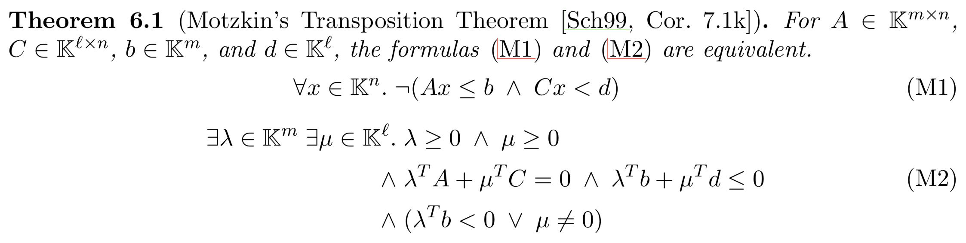
Synthesizing Ranking Functions

Slide 31
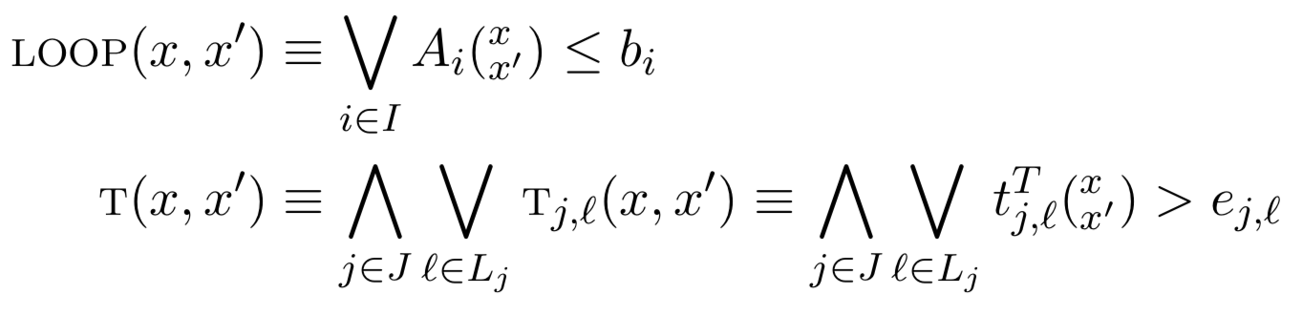
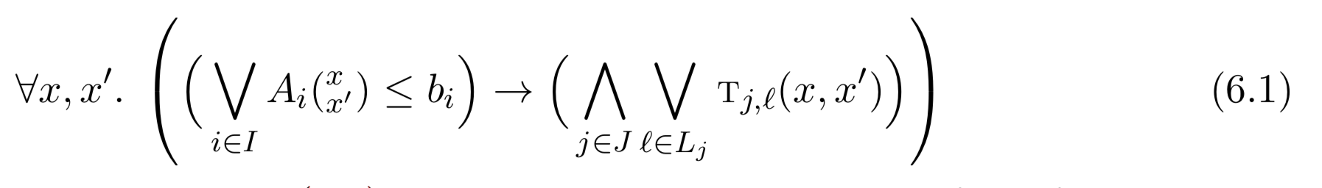
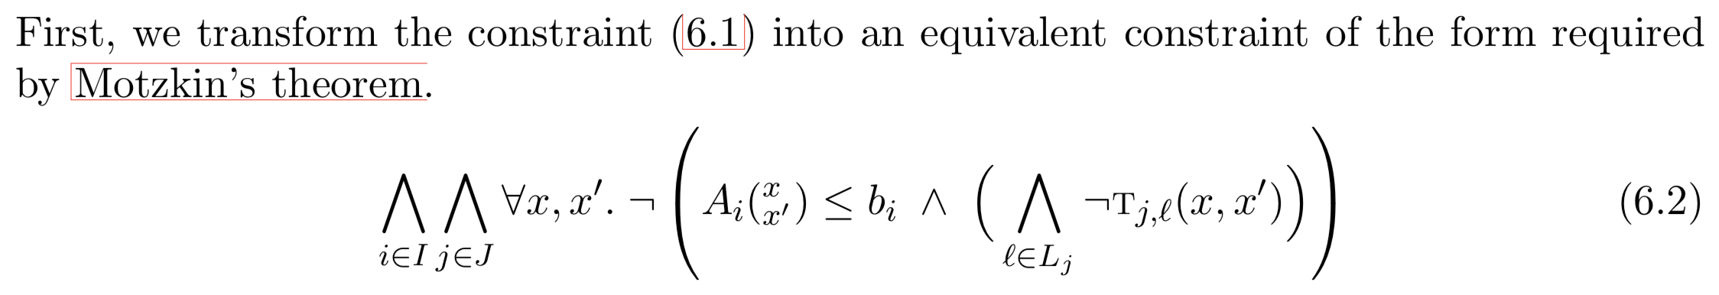
Constraint Transformation

Slide 32
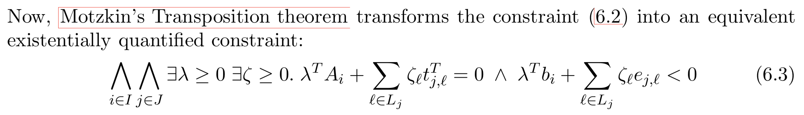
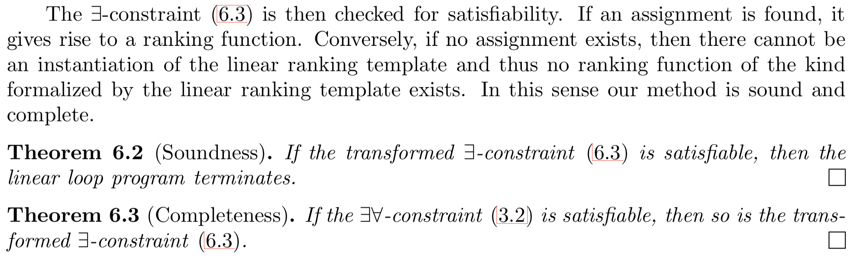
Constraint Transformation

Slide 33
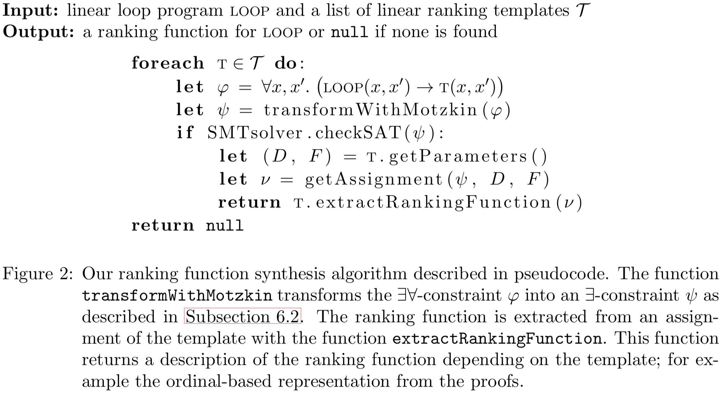
Ranking Template Pools
Notes:
Our method for ranking function synthesis can be applied as follows.
We fix a finite pool of linear ranking templates T , consisting of multiphase, nested, piecewise, lexicographic, and parallel ranking templates as well as composed templates in various sizes.
The input is a linear loop program LOOP that we want to check for termination.
We start by picking a linear ranking template T from the pool T .
From the ranking template T we build the constraint to the parameters and affine-linear function symbols of T.
This constraint is transformed using Motzkin’s theorem to an ∃-constraint.
If this constraint is satisfiable, this gives rise to a ranking function according to Lemma 3.5, and thus we proved that the loop program LOOP terminates.
Otherwise, we try again using the next linear ranking template from the pool T until the pool has been exhausted.
If the pool has been exhausted, the proof of the loop program LOOP’s termination failed.
However, due to the completeness of our method, we know that the loop program LOOP does not have a ranking function of the form specified by any of the linear ranking templates in the pool.

Slide 34
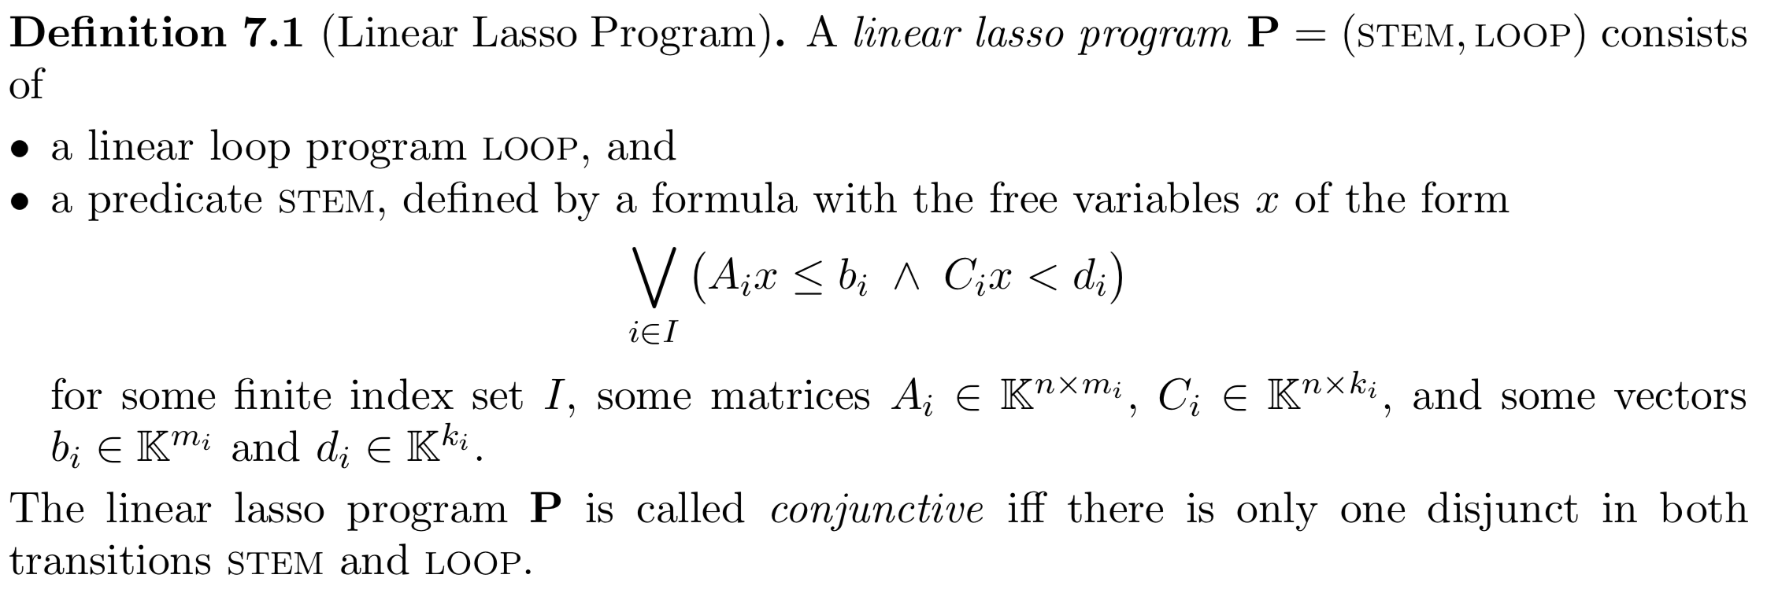
Linear Lasso Programs

Slide 35
Linear Lasso Programs

Slide 36
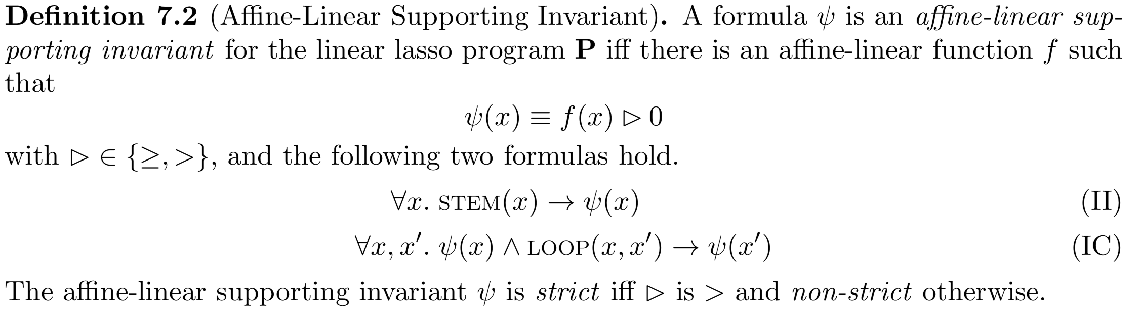
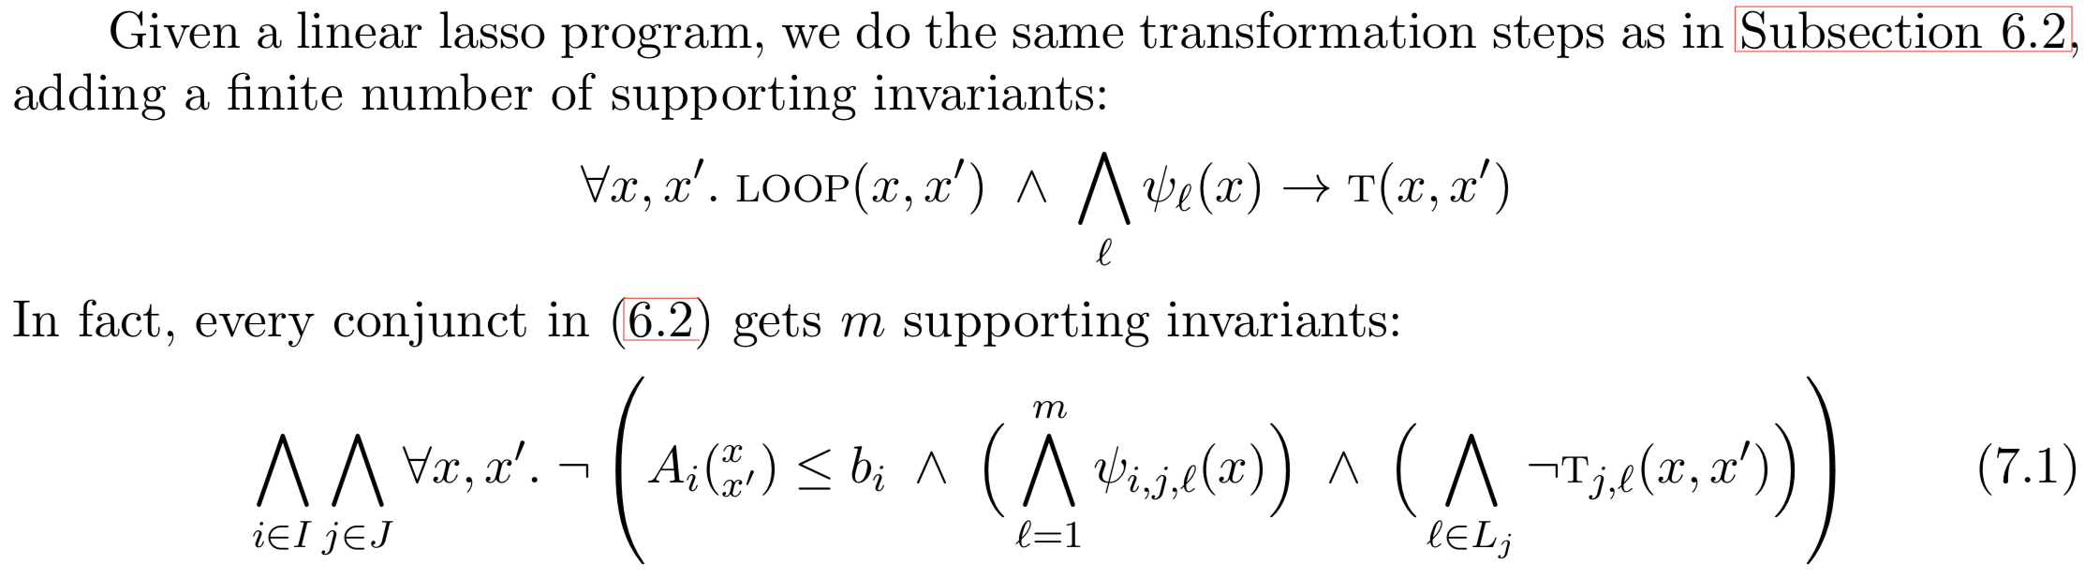
Linear Lasso Programs

Slide 37
Conclusion
We presented a sound and complete method for constraint-based synthesis of ranking functions for linear loop programs.
Our method can be applied to different kinds of ranking functions that previously have been considered independently (affine-linear and lexicographic ranking functions), in addition to enabling new kinds (multiphase, piecewise, and parallel ranking functions).
The ranking templates can also be composed into more powerful templates, allowing for more general ranking functions.
Our method can be applied to linear loop programs and linear lasso programs with variables that are rational numbers, real numbers, or integers.

